Slide 1
Testability + Fakes
Design for testability + Test types

Slide 2
Unit-Test recap
[TestFixture]
[TestCase]
Assert.That(x, Is.EqualTo(42)
How should we test the filter class?

Slide 3
Design for Testability - dependencies
“In order to test a functionality of a class, we first need to detach it from the rest of system in which it is designed to work. We then need to create an instance from that class, activate the tested functionality and finish by making sure the resulting behavior matches our expectations.
However, unless the system is designed specifically to enable this, in most cases, it will not be simple.”
Gil Zilberfeld, http://www.infoq.com/articles/Testability

Slide 4
Towards controlling dependencies
A testable design allows us to detach a single class (the UUT) from the rest of the system.
Then, we can control which dependencies the UUT uses, e.g. our “fake” versions of the dependencies
There are 3 steps towards control (III or Triple-I):
IDENTIFY Identify the external dependency
INTERFACE Introduce an interface (TAOUT: a seam) at the dependency
INJECT Replace (inject) the dependency

Slide 5
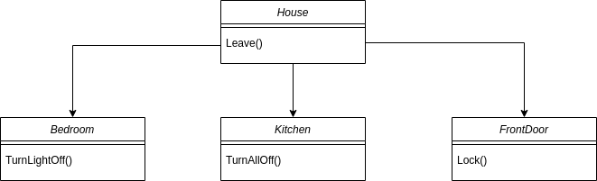
1: IDENTIFY the dependencies
Where are the
dependencies?
What is the problem?What is the design flaw?
class House
{
private readonly Bedroom _bedroom;
private readonly Kitchen _kitchen;
private readonly FrontDoor _door;
public House()
{
_bedroom = new Bedroom();
_kitchen = new Kitchen();
_door = new FrontDoor();
}
public void Leave()
{
_kitchen
.ShutDownAllAppliances();
_bedroom.TurnLightOff();
_door.Lock();
}
}

Slide 6
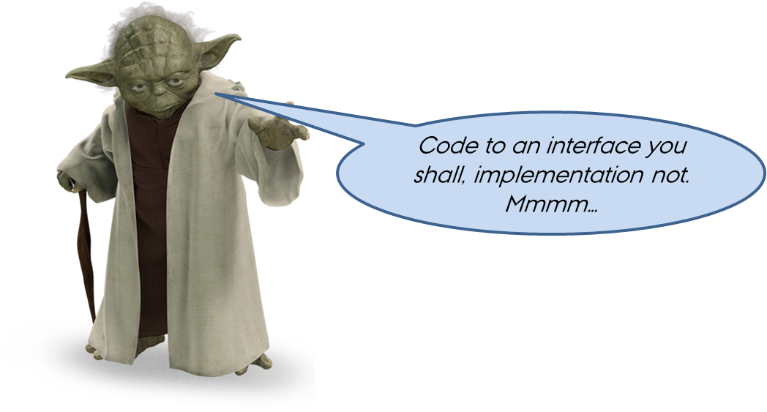
2: INTERFACE – Loosen the coupling
We can loosen the coupling by introducing interfaces to the dependencies

Slide 7
2: INTERFACE – Loosen the coupling
How can interfaces help us?
Where do the interfaces go?
How does this further testability?
What does House really want to do with the Bedroom?
“To call TurnLightOff() on its Bedroom object”, or
“To turn the light off in the bedroom”

Slide 8
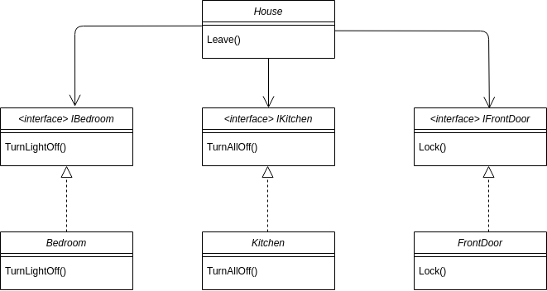
2: INTERFACE – Loosen the coupling

Slide 9
2: INTERFACE – Loosen the coupling
Are we happy now?
class House {
private readonly IBedroom _bedroom;
private readonly IKitchen _kitchen;
private readonly IFrontDoor _door;
public House() {
_bedroom = new Bedroom();
_kitchen = new Kitchen();
_door = new FrontDoor();
}
public void Leavehouse() {
_kitchen.ShutDownAllAppliances();
_bedroom.TurnLightOff();
_door.Lock();
}
}

Slide 10
2: INTERFACE – How to test?
class House {
private readonly IBedroom _bedroom;
private readonly IKitchen _kitchen;
private readonly IFrontDoor _door;
public House() {
_bedroom = new Bedroom();
_kitchen = new Kitchen();
_door = new FrontDoor();
}
public void Leavehouse() {
_kitchen.ShutDownAllAppliances();
_bedroom.TurnLightOff();
_door.Lock();
} }
class House {
private readonly IBedroom _bedroom;
private readonly IKitchen _kitchen;
private readonly IFrontDoor _door;
public House() {
_bedroom = new FakeBedroom();
_kitchen = new FakeKitchen();
_door = new FakeFrontDoor();
}
public void Leavehouse() {
_kitchen.ShutDownAllAppliances();
_bedroom.TurnLightOff();
_door.Lock();
} }
Change production code to test it :(

Slide 11
3: INJECT dependency
We would like to control the type of dependencies that House uses.
Fake or real
We do this by injecting the dependencies into House.
Remember: Since House uses interfaces to its’ dependencies, it does not care about their concrete types
So instead of letting House construct its own dependencies, we inject them into House
This means that we can isolate House from the rest of the system!

Slide 12
Constructor injection
// Production
class Program {
static void Main(string[] args) {
// Use constructor injection to inject reals
var house = new House(
new Bedroom(),
new Kitchen(),
new FrontDoor());
}}
class House {
private readonly IBedroom _bedroom;
private readonly IKitchen _kitchen;
private readonly IFrontDoor _door;
public House(IBedroom b, IKitchen k, IFrontdoor f) {
_bedroom = b ;
_kitchen = k;
_door = f;
}
public void Leavehouse() {
_kitchen.ShutDownAllAppliances();
_bedroom.TurnLightOff();
_door.Lock();
} }
// Test
[Test]
public void House_Ctor_ConstructorInj() {
// Use constructor injection to inject fakes
var uut = new House(
new FakeBedroom(),
new FakeKitchen(),
new FakeFrontDoor());
}
Remains unchanged

Slide 13
Property injection
// Production
class Program {
static void Main(string[] args) {
// Use default properties
var house = new House();
}
}
class House {
public IBedroom Bedroom {private get; set}
public IKitchen Kitchen {private get; set}
public IFrontDoor Door {private get; set}
public House() {
Bedroom = new Bedroom();
Kitchen = new Kitchen();
Door = new FrontDoor();
}
public void Leavehouse() {
Kitchen.ShutDownAllAppliances();
Bedroom.TurnLightOff();
Door.Lock();
}
}
[Test]
public void House_Ctor_PropertyInj() {
var uut = new House();
// Use property injection to inject fakes
uut.Bedroom = new FakeBedroom();
uut.Kitchen = new FakeKitchen();
uut.Door = new FakeFrontDoor();
}
Remains unchanged

Slide 14
Dependency injection – the silver bullet?
At some point, we must consider the real world in our system
Classics are “uncontrollable” dependencies
Time, file system, console, randomness, peripherals, …
We do not omit dependency inclusion, we defer it!
During unit testing (and initial integration testing), we isolate the use of these dependencies as much as possible
When time comes, we can integrate external dependencies with a high degree of confidence

Slide 15
Recap - Design for testability
A sensible design is required for testability
Primary concern: Dependencies = loss of control
Gain control by designing for loose coupling - Triple-I
Identify (the interface of) the dependency
Introduce an interface (seam) for the dependency
Inject the dependency
Control dependency type by dependency injection

Slide 16


Slide 17
Exercises
Start on ECG Exercise 1. - 3.
Continue on Hospital Bed 1. – 2.

Slide 18
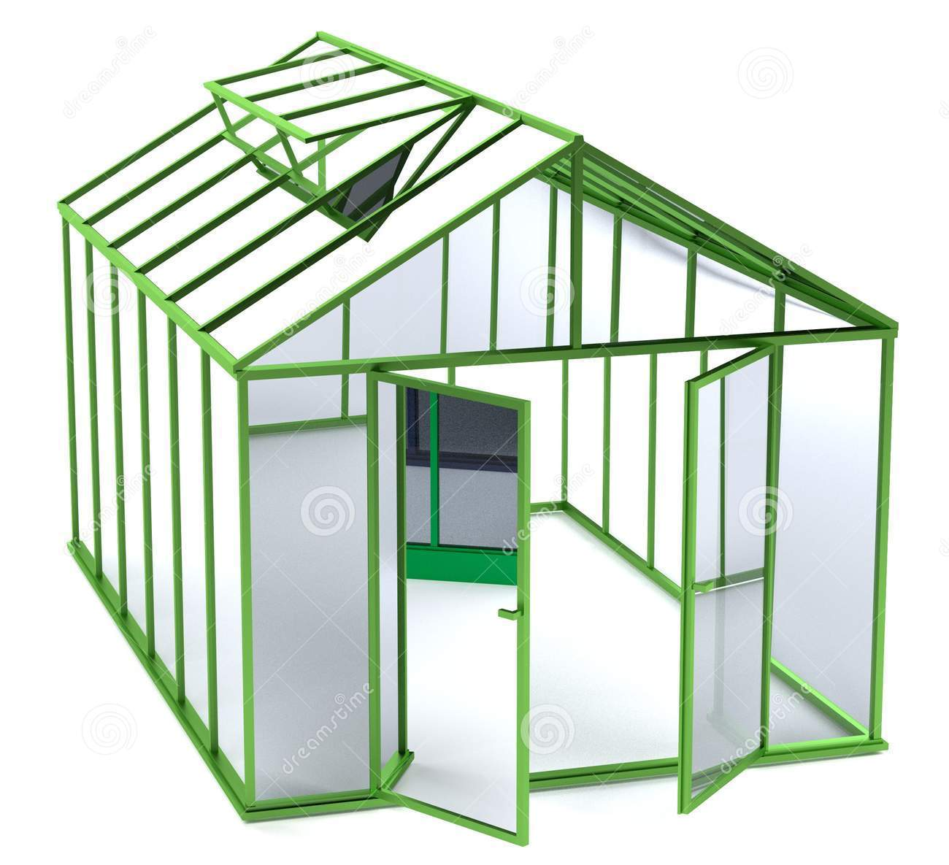
Environmental Control System

Slide 19
ECS
A very simple Environmental Control System (ECS) for temperature regulation in a greenhouse. Features:
Regulate the temperature
Get the last measured temperature
Regulation algorithm:
Measure temperature
Compare with threshold
Regulate temperature
Too hot → open window
Too cold → close window
Repeat from 1)

Slide 20
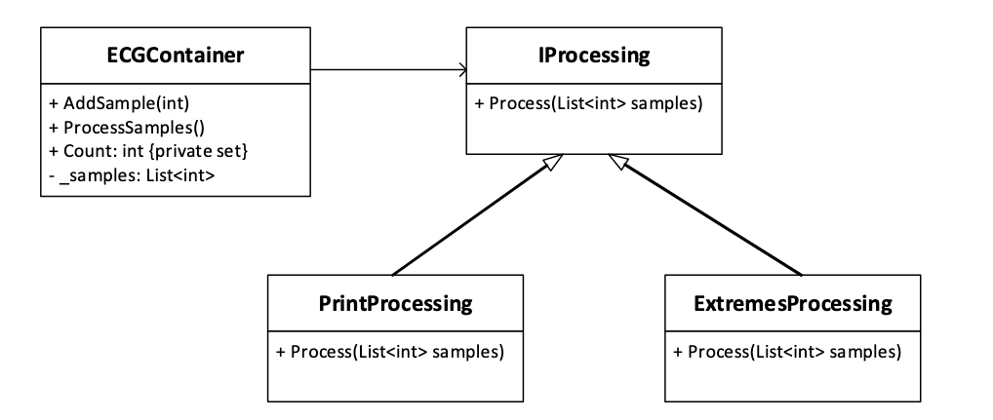
ECG - Design
Candidate design
We want to unit test the class ECGContainer. Discuss:
What are the dependencies of ECGContainer (Identify)
How can we lower the coupling (Interface)
How do we get the new dependencies into Control (Inject)
What test cases do we need to test LastTemp(a property)?
What test cases do we need to test Regulate()?
Are they state-based or interaction-based?
Are they state-based or interaction-based?

Slide 21


Slide 22
What is a fake?
WHAT: A fake is a “fake” version of a class
WHY: We use fakes to substitute a UUT’s “real” dependencies. We write the fakes, so we control their behavior. This means that we can test the UUT in isolation.
HOW: We enable the use of fakes by using Triple-I:
Identifying the dependencies
Inserting interfaces for them, and
Injecting the dependencies into the UUT

Slide 23
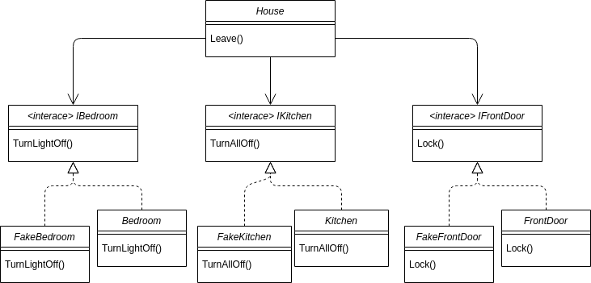
What is a fake - example
House has references to interfaces, so it does not know (or care) which concrete implementations it uses

Slide 24
Test types
Unit tests fall into one of two types:
State-based tests are used to test if the UUT is in the expected state after we have acted upon it.
Interaction-based tests are used to test if the UUT has had the expected interaction with its dependencies as a result of our acting upon it.
Each test type uses its own type of fake

Slide 25
State-based tests: Fake is a called STUB
For state-based testing, the fake is called a stub
Stubs exist to provide the UUT with the dependencies it needs to function (i.e. to return a value or just be present)
The procedure for state-based tests is the usual:
Arrange Setup your UUT (and its dependencies)
Act Stimulate the UUT
Assert That the UUT is in the expected state.
A stub can never cause a test to fail, since the assertion is on UUT, never on the stub

Slide 26
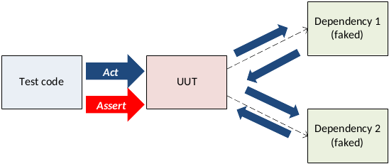
State-based tests - Assert on UUT
Arrange Setup your UUT (and its dependencies)
Act Stimulate the UUT
Assert That the UUT is in the expected state.
In a state-based test, the assertion is ALWAYS on the UUT, NEVER on the fake(s)

Slide 27
Interaction-based tests: Fake is called a Mock
For interaction-based testing, the fake is called a mock
We wish to test that the UUT had the expected interactions with the dependencies, so the mock must “record” if the interaction took place
The procedure for interaction-based tests is the usual:
Arrange Setup your UUT (and its dependencies)
Act Stimulate the UUT
Assert That the mock received the expected interactions with the UUT.
The mock can cause a test to fail since the assertion is on the mock.

Slide 28
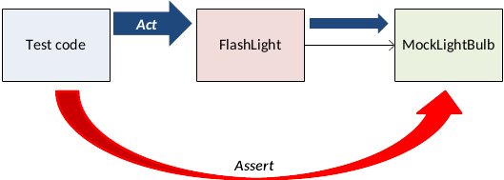
Interaction-based tests: Assert on Mock
In interaction-based tests, we also follow the Arrange-Act-Assert strategy.
Assertions are on the mock object – not the UUT
In an interaction-based test, the assertion is on the mock, not the UUT

Slide 29
Exercises
Start on ECG Exercise 1. - 3.
Continue on ECG Exercise 4. - 6.
Continue on Hospital Bed 1. – 3.

Slide 30
ECG - Fakes
Candidate design
We want to unit test the class ECGContainer. Discuss:
What are the dependencies of ECGContainer (Identify)
How can we lower the coupling (Interface)
How do we get the new dependencies into Control (Inject)
What test cases do we need, to test Count(a property)?
What test cases do we need, to test ProcessSample()?
Are they state-based or interaction-based?

Slide 31
ECS - Fakes
Do we have state based tests?
What do we test with these?
Do we have interaction based tests?
What do we test with these?

Slide 32
Caution: Avoid complex mocks
To allow assertions to be made, the mock will to store….what?
The fact that a method was called
Number of times a method was called
Parameters
Call sequence
This typically make mocks more complicated than stubs
Take longer to write, harder to re-use, more error-prone
Soon, you will have to test the mocks :(
Protip: Strive to keep your mocks simple

Slide 33
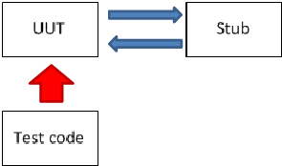
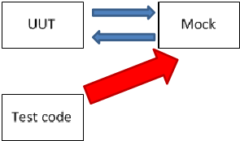
Recap - test types
The big differences between state- and interaction-based tests is where you make the assertion
State-based test (stubs)
Test acts on UUT - UUT might interact with stub, but will change state
Test asserts that UUT assumed the expected state
Interaction-based test (mocks)
Test acts on UUT - UUT interacts with mock and might change state
Test asserts on mock that UUT interacted as expected with the mock

Slide 34
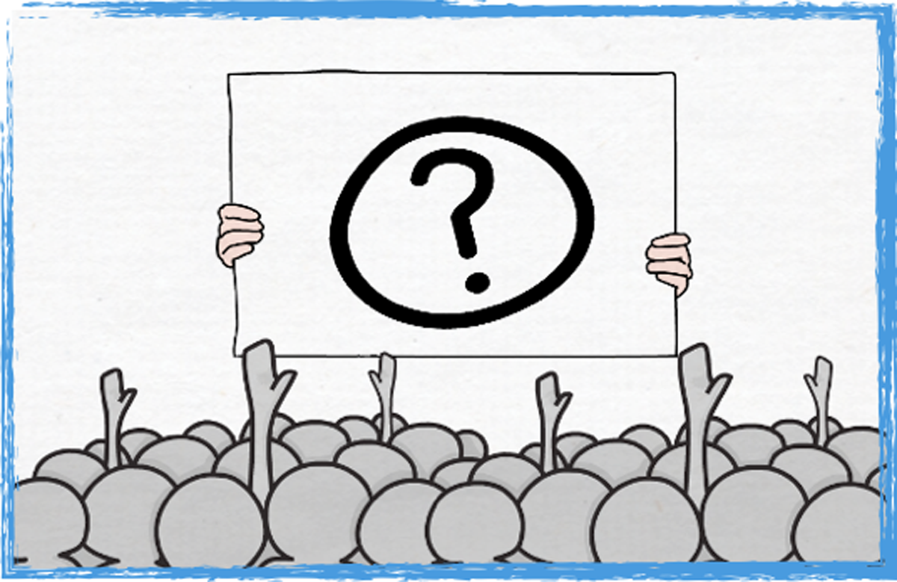

Slide 35
